Slide 1

Psychological Measurement Week 6 Hour 2
Dr Oliver Clark

Slide 2
Learning Outcomes
Be able to locate and interpret validity evidence
Be able to apply validity evidence to link measured to unmeasured variables

Slide 3

‘Fake example using real publication’
A psychometrics company wants to recruit sales people and use some tests to screen recruits
They want people who will close sales

Slide 4
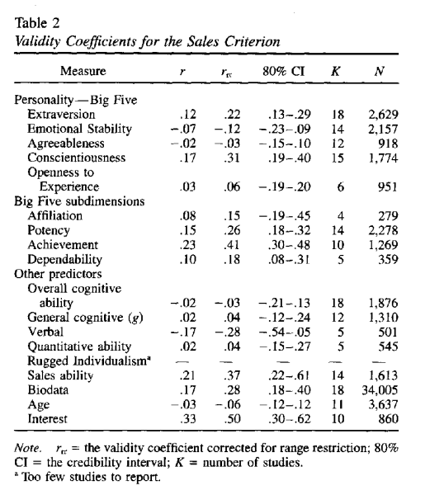

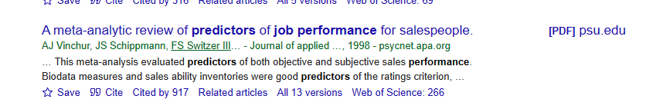
Check the literature
If we want to maximise sales, then screening for extraversion and conscientiousness might be a good start

Slide 5
Applied (Fake) Example
Example
You have been handed a person’s DOPISDO profile and have been asked about likely behaviours for someone with a similar profile:
 | Dormaus | Open to Crit | Perfectionist | Inner-thinking | Sagacity
Raw | 6
T score | 59.3
 | Dormaus | Open to Crit | Perfectionist | Inner-thinking | Sagacity
Mean | 5.1
SD | 0.97
Alpha | 0.86
SEM | 0.36
T SEM | 3.74

Slide 6
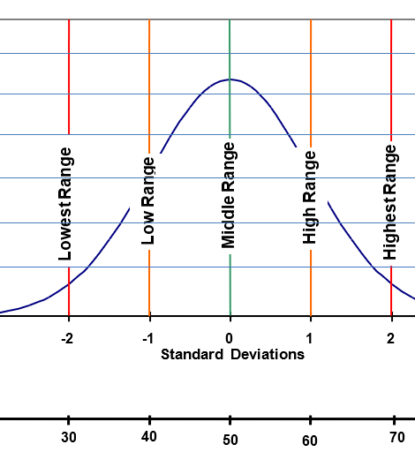
Example
Their T score was 59.3, so their range is:
59.3 – 3.74
59.5 +3.74.

Slide 7

Example
Someone who scores high on the Dormaus attribute is more likely to be found sleeping on the job!

Slide 8

Task
Repeat this process with some of the other variables

